Slide 1

watsonx Orchestrate: Introduction and Architecture
Notes:
This presentation provides an overview of the architecture of watsonx Orchestrate, it describes its principal components and how they work together, enabling you to build solutions that exploit the capabilities of the platform.

Slide 2
Seller guidance
and legal disclaimer
Slides in this presentation marked as "IBM
and Business Partner Internal Use Only"
are for IBM and Business Partner use
and should not be shared with clients
or anyone else outside of IBM or the
Business Partners’ company.
© IBM Corporation 2025.
All Rights Reserved.
The information contained in this publication
is provided for informational purposes only.
While efforts were made to verify the completeness and accuracy of the information contained in this publication, it is provided AS IS without warranty
of any kind, express or implied. In addition, this information is based on IBM’s current product
plans and strategy, which are subject to change
by IBM without notice. IBM shall not be responsible
for any damages arising out of the use of, or otherwise related to, this publication or any other materials. Nothing contained in this publication is intended to,
nor shall have the effect of, creating any warranties
or representations from IBM or its suppliers
or licensors, or altering the terms and conditions
of the applicable license agreement governing
the use of IBM software, IBM hardware,
or IBM services.
References in this presentation to IBM products, programs, or services do not imply that they will
be available in all countries in which IBM operates.
Product release dates and/or capabilities referenced
in this presentation may change at any time at IBM’s sole discretion based on market opportunities or
other factors and are not intended to be a commitment
to future product or feature availability in any way. Nothing contained in these materials is intended
to, nor shall have the effect of, stating or implying
that any activities undertaken by you will result
in any specific sales, revenue growth,
or other results.
All client examples described are presented
as illustrations of how those clients have
used IBM products and the results they
may have achieved. Actual environmental
costs and performance characteristics
may vary by client.
IBM and Business Partner
Internal Use Only
Notes:
This self-explanatory slide shares seller guidance and legal disclaimers for this presentation.

Slide 3
Agentic concepts in watsonx Orchestrate

Slide 4
Building an AI Agent in watsonx Orchestrate
Search
An AI agent is an autonomous system capable of utilizing tools and collaborating with other agents to plan and execute tasks.
After taking action, the agent reflects on the outcomes of its actions, learning iteratively and refining its approach to better align with its pursuit of a defined goal.
In watsonx Orchestrate, agents are created using knowledge, toolsets and a behavioral framework.
Knowledge
Glossary
Tools
Agent
Toolset
Collaborators
Guidelines
Behavior
Triggers
Notes:
Now that we have some understanding of agentic systems and how they operate, let’s examine the agentic framework in watsonx Orchestrate. We’ve looked at agents previously in some detail, and within Orchestrate the agentic framework is extended to include knowledge, toolsets and behavior:
Knowledge can include documents uploaded into the agent directly or held in an external repository supporting conversational search.
The toolset can include tools and their credentials, and delegation to other collaborating agents.
Behavior provides the agent with additional instructions to improve its accuracy and can include guidelines providing specific instructions to apply in certain circumstances.

Slide 5












IBM watsonx Orchestrate – Agentic capabilities
Customers
Employees
Subject matter experts
Deploy and use
Agentic AI Orchestration
Think
Plan
Route
Reflect
Agent Catalog
IBM Pre-built agents: HR, Sales, Procurement , Finance, Customer Care , IT
3rd party agents
IBM Partner agents
Custom-built agents
AI agents
Integrate custom built or external agents and assistants to automate complex tasks.
Tools
Pre-built and custom APIs and automations that can be used by agents
Agent Connect
IBM partners can build and publish agents in the Agent catalog
Build and manage
Low code Agent builder
Create AI agents in minutes—no coding required
Agent Development Kit (ADK)
Create custom agents and tools
Gen AI powered by watsonx.ai
Access or bring task specific LLMs
AI Model Gateway
Access third party LLMs and embeddings.
Agent Ops – monitor and govern and lifecycle management
Notes:
This diagram provides a high-level overview of watsonx Orchestrate AI Agents capabilities.
At the top of the stack, watsonx Orchestrate serves as the central orchestration layer, thinking, planning, routing, and reflecting on work across departments and use cases. This orchestration layer acts as an intelligent supervisor, coordinating how work is executed by AI agents, whether they are prebuilt, custom-developed, or sourced from third parties. Users—whether employees, customers, or subject matter experts—can engage through natural language in familiar channels, such as Slack, web chat, or voice. From there, watsonx Orchestrate routes requests to the appropriate agents, workflows, or tools needed to fulfill that task.
To build and manage these Agentic capabilities, watsonx Orchestrate provides a complete toolchain:
The Low-Code Agent Builder enables business users to quickly create agents without technical skills.
The Pro-Code Agent Development Kit (ADK) enables more complex and customized agent development by technical teams.
IBM watsonx.ai provides access to IBM and third-party models hosted by IBM.
The AI Model Gateway enables use of external, third-party models.
Watsonx Orchestrate also comes with an Assistant builder tool but here we are focusing on the Agentic capabilities of the product.
In this presentation we’ll examine how the build and manage capabilities provided by watsonx Orchestrate are used to implement agentic systems.

Slide 6


AI agents taxonomy
Agent
orchestration
Agents
Tool Catalog
Tools
Client Layer
End User
Conversational Interface (Web, Slack, Teams, Mobile, Voice**)
Tool Catalog
Agents
APIs & Apps
Custom-built agent
Actions & Dialog
Knowledge
Pre-built Agent
Biz
Automation
Pro-Code Tools
3rd party agent
Enterprise Apps &
Business Processes
Data Sources
Prebuilt
tools
wx Assistant 1
Notes:
Let’s remind ourselves of the AI Agent and Tool taxonomy in watsonx Orchestrate.
After receiving the user request, autonomous AI agents fulfill tasks or drive multi-step use cases. These agents are purpose-built, can use tools, and can even collaborate with each other to complete work. Tools are modular, composable, reusable and purpose-built for the agent paradigm—they can be invoked programmatically and dynamically by agents at runtime.
Let’s zoom in and look at the definition of a simple agent deployed on watsonx Orchestrate.

Slide 7
Agent styles
Default
ReAct (Reasoning and Acting)
Plan-Act (Planner)
Streamlined, tool-centric, for straightforward tasks with linear logic.
Relies upon LLM reasoning to decide which tool to use, how to use it, and when to respond.
Ideal for:
Single-step or lightly sequential tasks
Flexibility and adaptability are needed
Multiple tool calls without strict sequencing
Iterative loop where the agent thinks, acts and observes continuously.
Adjusts it plan based on what it learns along the way.
Ideal for:
Exploratory tasks
Problem solving
Transparent reasoning is needed
Emphasizes up-front planning and creates a structured plan to arrive at the goal.
Provides various options for controlling output.
Ideal for:
Multi-step, structured workflows
Control of agent output
Transparency and traceability
Notes:
There are different agent styles available in watsonx Orchestrate that are better suited for certain situations.
The default agent style takes a more simplistic approach and is ideal for simple tool calling and linear tasks. It’s fast and uses the LLM to work out how to break down the task into a sequence of steps. Unlike ReAct , the agent does not plan continuously, and this can be advantageous for simpler sequential tasks.
ReAct agents think, act, observe and reason in a continuous loop, and they adjust the plan as they work towards the solution. This style of agent is well suited to problem solving where continuous reasoning and replanning is needed, and where the route to a solution may not be obvious from the outset.
Plan-Act agents emphasize up-front planning and have increased control over how the agent produces output. We’ll explore Plan-act in more detail in the next few slides.

Slide 8
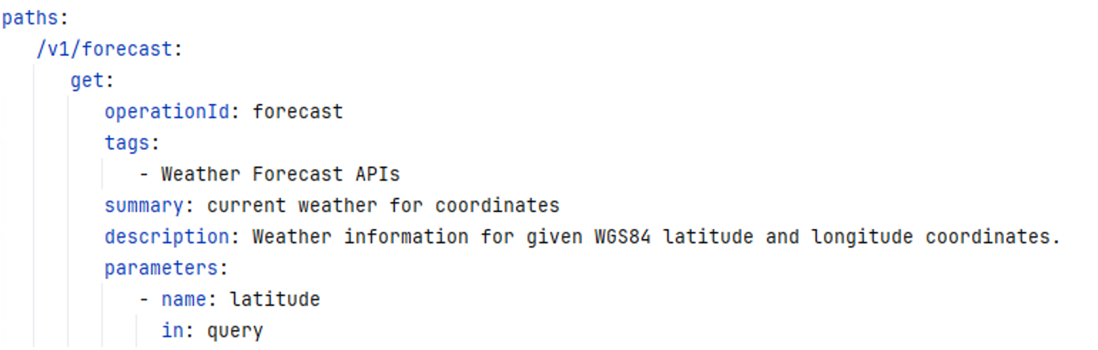
ReAct agent example
Agent: Weatherman
This simple agent provides the current temperature for a given city.
Description: describes the agents' capabilities
Instructions: helps the agent plan to achieve its goals
The tool is created from an Open API specification.
Description: describes the capabilities of the tool
Parameters: information that must be provided by the agent
The Open API specification used to create tool.
Description:
You provide the current temperature for well known cities.
Instructions:
Use the forecast tool to get the current temperature. Display the results as a text sentence.
Try and determine the longitude and latitude yourself before calling the forecast.
For example, Berlin, Germany is 52.52,13.41.
Tool: Forecast
Description:
Retrieve current weather conditions.
Parameters:
Latitude
Longitude
Open API: Forecast
Notes:
Let’s start with a simple default agent. This is a logical representation of the weatherman agent you will create later in this course.
The agent contains a description of the agents' capabilities, and some instructions that help the agent respond to the questions it receives. There is also additional information about the tool the agent can use, how the response should be formatted, and a suggestion to determine the longitude and latitude if the user didn’t provide these parameters.
The forecast tool used by the agent is generated from the OpenAPI specification of an external weather service. The tool description helps the agent select the tool, and the tool definition also declares any parameters that are needed.
The information in the OpenAPI specification is used to generate the tool, it contains the endpoint, authorization and data models that must be used.

Slide 9
ReAct prompt in Orchestrate
You run in a loop of Thought, Action, PAUSE, Observation. At the end of the loop you output the Answer.
Answer the user's question as best as possible using the available tools.
If parameters required to execute a tool is missing, try to infer it from conversation history else ask the user for it one by one.
If the user greets you (e.g., "hi", "hello"), respond with: "Hello! I am Watsonx Orchestrate, an AI assistant, created by IBM. How can I help you today?" and nothing else.
You have access to the following tools to use as actions: [{'type': 'function', 'function': {'name': 'forecast', 'description': 'Weather information for given WGS84 latitude and longitude coordinates.', 'parameters': {'latitude': {'description': 'WGS84 coordinate', 'title': 'Latitude', 'type': 'number'}, 'longitude': {'description': 'WGS84 coordinate', 'title': 'Longitude', 'type': 'number'}, 'current_weather': {'title': 'Current Weather', 'type': 'boolean'}}}}]
Use the following format:
Thought: your thoughts about what to do next
Action: the action to take in the form of a JSON tool call with json formatted input parameters. The object must contain two fields, name (string, name of the tool to call) and arguments (object, the arguments to pass to the tool)
For example, Action: {"name": "run_code", "args":{"code": "print('Hello world!')", "language": "python"}} When generating tools calls for actions
PAUSE
If there is no action to take, output the Answer that this question is beyond my capability.
If an action is required, you must PAUSE and wait for the next call.
After the PAUSE, the user will respond with the result of the action. DO NOT TRY TO PLAN AHEAD. YOU MUST WAIT FOR THE USER TO RESPOND. The user response will look like this:
Observation: the result from taking the action ...(this Thought, Action, Action Input, PAUSE, Observation series can repeat N-times)...
If parameters are missing you will respond like this:
Collect: Your question to collect missing parameters
Once you know the final answer, you respond like this:
Thought: I know the final answer
Answer: your final answer to the original input question
Use the forecast tool to get the current temperature. Display the results as a text sentence. Try and determine the longitude and latitude yourself before calling the forecast. For example, Berlin, Germany is 52.52,13.41
The current date is July 08, 2025.
1
4
2
5
3
6
Notes:
The definition of a default agent is quite simple, but for the agent to use the LLM effectively, the instructions must be converted into a prompt. This is the Reasoning and Acting (ReAct) prompt created by watsonx Orchestrate that incorporates chain-of-thought reasoning, looping, tool calling, and specific instructions for the weatherman when using the forecast tool. We don’t create this prompt, that’s handled by watsonx Orchestrate, but it's useful to know what’s happening within the system. Even without technical expertise, most of the prompt is readable and provides insight into how instructions are communicated to the large language model (LLM).
Let’s walk through some of its key sections.
Loop and Tool Access: The prompt begins by informing the LLM that it operates in a loop consisting of thought, action, and observation. At the end of the loop an answer must be provided. It also specifies that the LLM has access to external tools and provides some guidance for using them.
Forecast Tool Instructions: The next section outlines how the forecast tool should be used. While this part is more technical, it clearly defines the the tool function and any required parameters.
Response Formatting: This block explains how the LLM should format its responses to the agent. It includes instructions for appending chat history after each loop and provides a place for the LLM to reference its previous reasoning.
Handling Observations and Missing Parameters: The prompt then tells the LLM to expect observations from tools. Just below, there’s an instruction for the LLM to request any missing parameters it needs to proceed.
Declaring the Final Answer: A crucial instruction follows - the LLM is told how to declare when it has reached the final answer. The phrase “I know the final answer” is used as a signal for the agent to parse and recognize completion.
Specific Forecast Tool Instructions: Finally, the prompt includes detailed instructions for using the forecast tool, derived directly from the agent’s configuration.
Next let’s have a look to the 3rd agent category: the Plan-act agents.

Slide 10
Plan-Act agents
Planning
The complete execution plan to arrive at the goal is created at the start
of processing.
Scope
The execution plan only contains tools and collaborators defined in the agent.
Execution
The Orchestrate system will execute each task in the execution plan and store the results.
Data
The Orchestrate system uses the LLM/Agent to determine what information to pass to a task, only the minimum is provided.
Notes:
ReAct agents can perform well but the results they produce can be inconsistent, even when processing similar requests. ReAct agents work towards a goal incrementally, re-planning at each step, with full access to the conversation history and a considerable degree of creative license and initiative. These qualities can be useful for certain tasks where problem solving and exploration is needed to arrive at the goal.
Plan-Act agents provides improved accuracy and consistency for less complex problems. A plan-act agent creates its execution plan at the start of processing and will only deviate from the plan in certain situations. The scope of actions available to the agent is restricted to a specific list of tools and collaborators. The Orchestrate system will execute each task in the execution plan in sequence, and will store the results of each task. If a task requires data from a previously executed task, Orchestrate will provide only the minimum required. This contrasts with a ReAct agent where the large language model can pause and infer facts for itself, and has access to the complete conversation history so it can determine for itself what data it should be using.

Slide 11
Plan-Act agent output
Custom join
Structured output
LLM generated
A custom join is performed using a Python tool.
The tool has full control of the response format and can include any logic needed to produce a response in the required format.
The required response schema is specified in the agent definition.
This provides the agent with a precise description of the output needed.
Not as powerful as a Python tool but enables the LLM to perform better when a precise output format is required.
Like a ReAct agent, the LLM will generate the response.
The LLM will determine how to format the response and may not be sufficiently accurate when a precise output format is required.
Notes:
Plan-act agents also have greater control over how the response is produced. These agents can be configured to use a custom join, a Structured output, or rely on the LLM to generate a response. Whichever response type is used, a plan-act agent has access to the original query, task results and the message history.
A custom join is a Python tool with full control over how the response is created. It can apply programmatic logic and validation to ensure the response is created correctly.
Structured output provides the agent with a schema for the response and improves the accuracy of the response by providing the LLM with a precise specification of what should be generated.
As a fallback, a plan-act agent can also rely in the intrinsic abilities of the large language model (LLM) to produce a response. This can work well, but the accuracy of the response will not be as high when compared to structured output or a custom join. Sometimes the LLM will work well, but on other occasions the LLM can ignore instructions and produce unexpected output.
If response consistency and accuracy is important, custom joins or structured output will produce better results.

Slide 12
Tools in watsonx Orchestrate
Overview
Tool types
Tool connections
In agentic systems, a tool refers to a specialized capability or function that an agent can use to perform tasks, interact with the environment, or achieve goals.
Tools are typically modular and can be invoked by the agent when needed.
Pre-built tools for HR, IT, procurement, sales, and productivity.
Custom tools from OpenAPI specifications or Python.
Created using flows that perform a sequence of steps.
MCP tools use a standardized protocol to provide access to a wide range of systems.
Provide a secure connection between watsonx Orchestrate and external systems.
Connections:
API Key
Basic Auth
Key Value Pair
Bearer Token
OAuth
Notes:
Another key concept in Agentic AI is Tools.
Let’s take a closer look at the tools within watsonx Orchestrate and how they enable agents to perform tasks efficiently and securely.
In agentic systems, a tool is essentially a specialized capability that an agent can call upon to complete tasks, interact with its environment, or achieve specific goals. These tools are modular, meaning they can be invoked as needed, allowing for flexible and dynamic task execution.
There are several types of tools available:
Pre-built tools designed for common business functions like HR, IT, procurement, sales, and productivity.
Custom tools can be created using OpenAPI specifications or Python, allowing for tailored functionality.
Tools can also be built using flows, which are sequences of steps that define a process.
MCP tools follow a standardized protocol, enabling broad access to various systems and services.
To ensure secure and reliable integration with external systems, watsonx Orchestrate supports multiple connection types:
API Key
Basic Authentication
Key-Value Pairs
Bearer Tokens
OAuth
These connection methods help maintain data integrity and security while enabling seamless tool usage.

Slide 13
Understanding the agent runtime elements

Slide 14
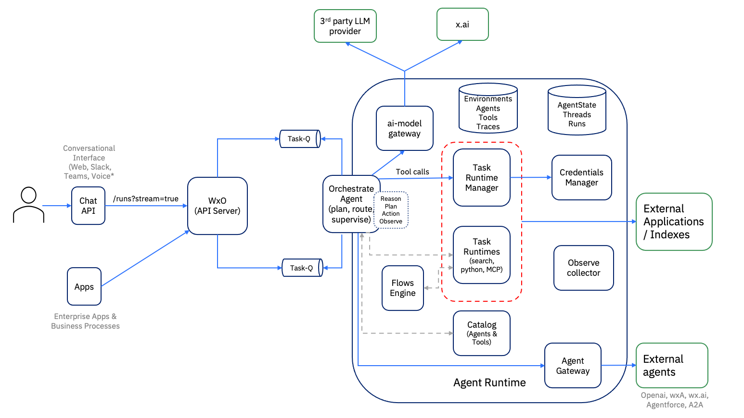
Agent runtime
The agent runtime receives chat requests from the API server.
Responsibilities:
Agent orchestration
Agent state
Gathering trace data
Calling external apps
Calling external agents
Invoking LLMs
Notes:
Ultimately the agent framework used by watsonx Orchestrate is used to produce agents that can be deployed to a runtime. This slide describes the architecture of the agent runtime, highlighting the key components and their interactions during task execution.
The core responsibilities of the agent runtime are to provide:
Agent orchestration: Coordinating the flow of interactions into agents and managing task execution.
Agent state: Maintaining context and memory across interactions.
Gathering trace data: Capturing logs and telemetry for observability.
Calling external apps: Integrating with third-party systems and APIs.
Calling external agents: Enabling collaboration between agents running in watsonx Orchestrate, and agents running externally.
Invoking LLMs: Leveraging large language models for reasoning and generation that are hosted by IBM or provided by third party providers.
The Chat API serves as the entry point for user interactions coming from Web, Slack, Teams or voice channels using Orchestrates streaming API. These requests are routed through to the API Server, which acts as the central hub for chat interactions that are forwarded to agents deployed on the platform. Enterprise apps and business processes can interact directly with the API server if they don’t require a streaming interface. The API server provides these apps with a simpler chat-completions API for interacting with agents when streaming isn’t required.
Agents use the AI-model gateway, which handles communication with language models, and the Task Runtime Manager, which oversees the execution of tasks.
Tasks are executed within Task Runtimes, which manage memory and runtimes in isolated environments. The Credentials Manager ensures secure access to external systems, while the Observe Collector gathers telemetry data for monitoring and debugging. The Agent Gateway facilitates communication with external applications, indices, and other agents, enabling a rich ecosystem of integrations.
In the subsequent slides we will explain the role of these components and how they work together.

Slide 15
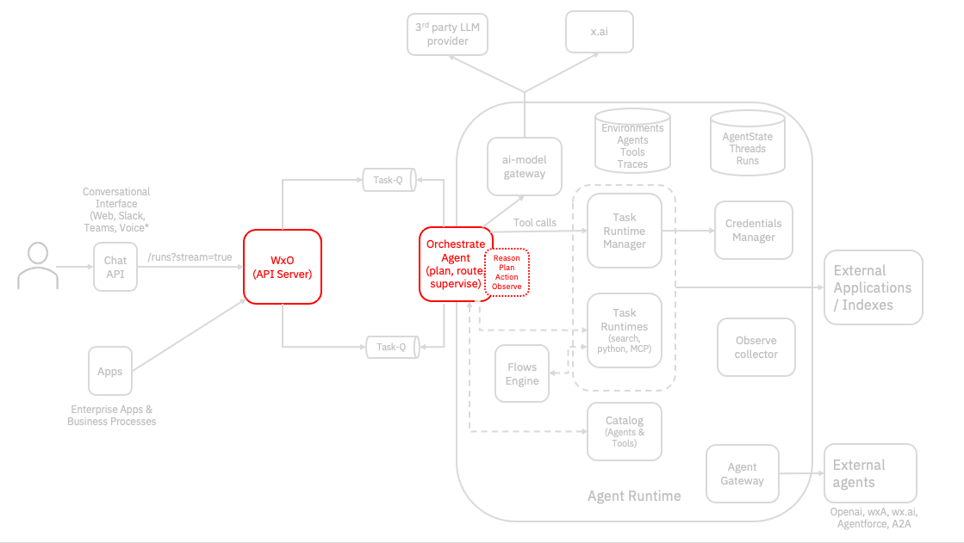
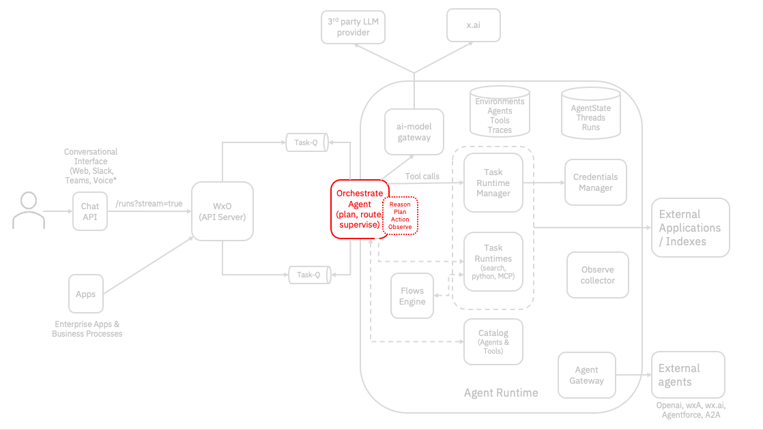
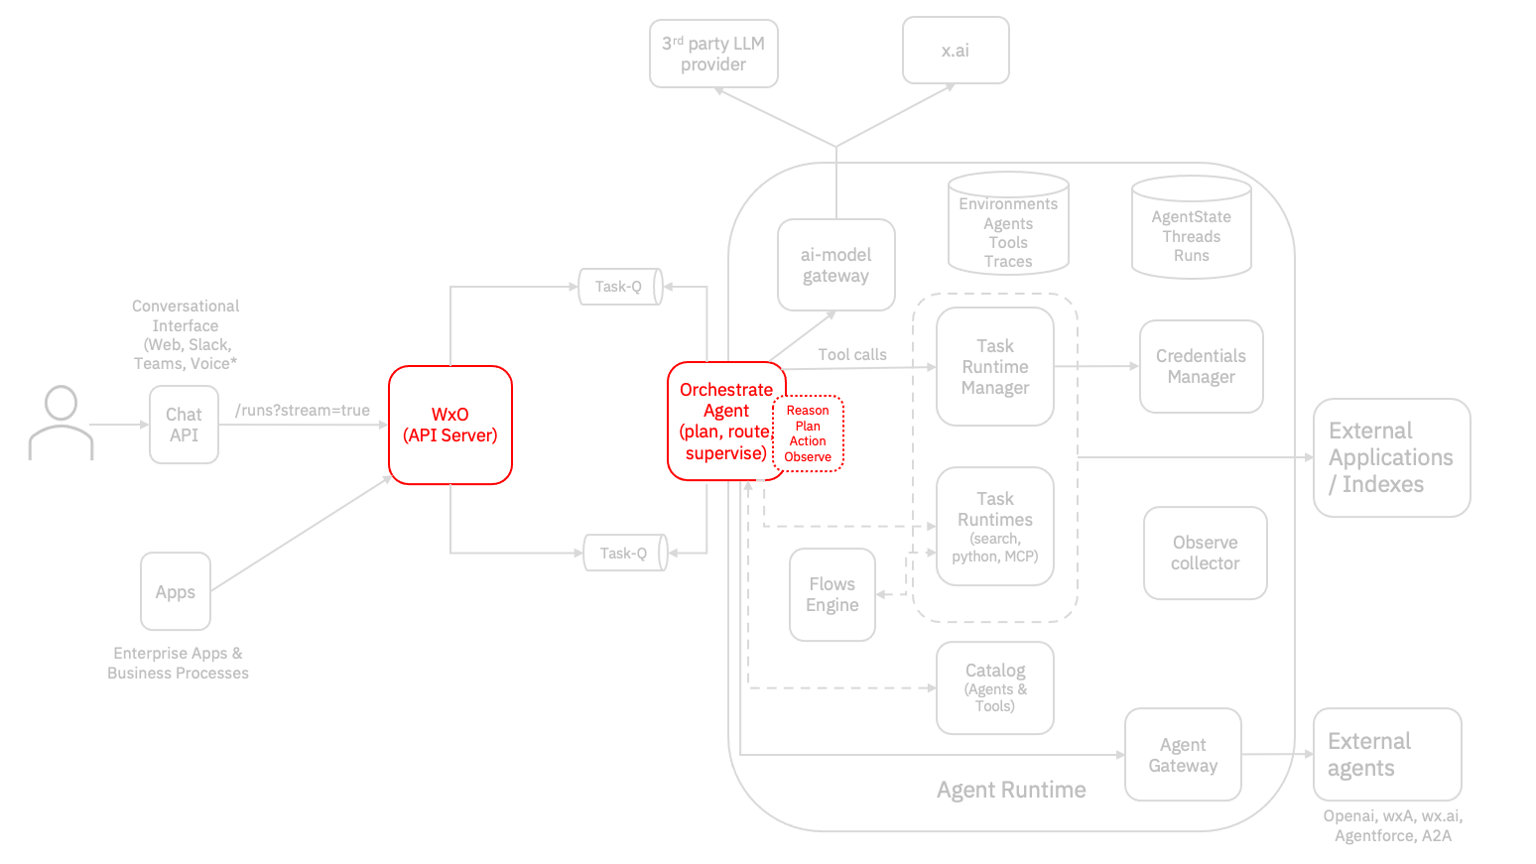
API Server/Orchestrate Agent
API Server
The API service, which hosts the HTTP endpoints, provides APIs to create, update, and delete Orchestrate’s primary entities—such as agents, tools, and external agents.
APIs for managing releases.
Provides OpenAPI endpoints for interacting with agents.
Orchestrate Agents
An Orchestrate Agent is an AI assistant that interprets a user’s query and executes the requested task by leveraging available tools and configured collaborators, which can be either native or external agents. Native agents can use one of three styles:
Default – Selects the appropriate tools or collaborators needed for the task.
ReAct – Follows a “think, act, observe” loop for each step, adapting dynamically.
Plan-Act – Creates a complete execution plan upfront based on the query, then executes each step in sequence.
Notes:
This slide describes the API Server and Orchestrate agents that are deployed on the platform.
On the left, we have the API Server, which plays a foundational role in the orchestration framework:
It hosts HTTP endpoints that expose APIs for managing key entities such as agents, tools, and external agents.
These APIs allow users to create, update, and delete these entities, and it supports APIs for managing releases
The API server provides direct interaction with agents using OpenAPI
On the right, we have an Orchestrator Agent, which acts as an AI assistant. It interprets user queries and executes tasks by leveraging available tools and collaborators. Collaborators can be either native agents running in Orchestrate or external agents running outside of Orchestrate, depending on the task requirements.
Native agents operate in one of three styles:
Default – Automatically selects the most appropriate tools or collaborators for the task.
ReAct – Uses a dynamic loop of 'think, act, observe' to adapt its actions step-by-step.
Plan-Act – Builds a complete execution plan upfront and then follows it sequentially.

Slide 16
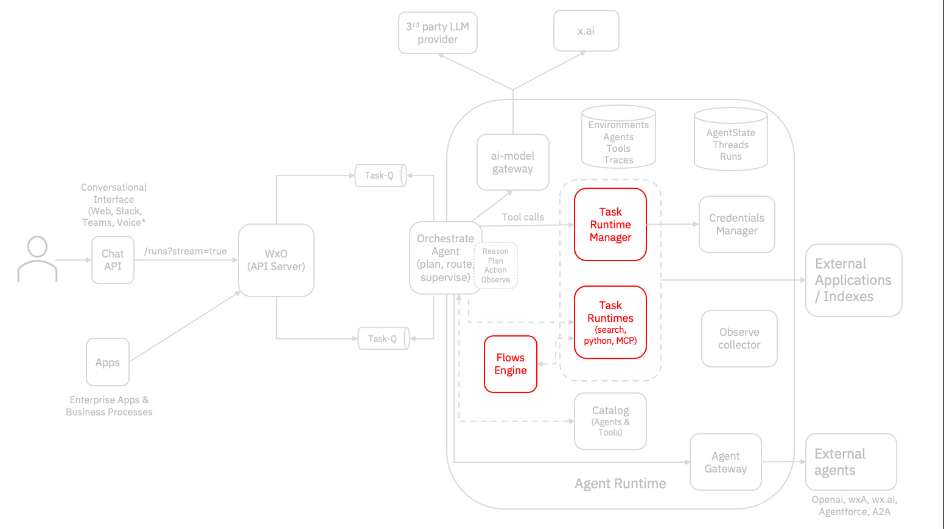
Task Runtime Manager/Flow Engine
Task Runtime Manager
The Task Runtime Manager is responsible for running tools within Orchestrate. It supports the following types of tools:
Open API
Python
Knowledge Base (KB)
Model Context Protocol (MCP)
The Task Runtime Manager will call OpenAPI tools directly. For other types of tools, it will spin up a dedicated container to run KB, MCP and Python type tools to provide isolation.
Flow Engine
The Flow Engine is responsible for executing asynchronous, event-driven workflows, providing precise control over how tasks are carried out by coordinating between various tools and agents.
Unlike autonomous agents, flows offer predictable, deterministic behavior for orchestrating complex operations.
Flows can run a growing palette of tasks including User Activities, Generative AI prompts, Decision Tables, Document Classifiers and Document Processors.
Notes:
This slide describes the Task Runtime Manager and the Flow Engine.
On the left, we have the Task Runtime Manager, which is responsible for running tools within Orchestrate. It supports four main types of tools:
OpenAPI
Python
Knowledge Base (KB)
Model Context Protocol (MCP)
For OpenAPI tools, the task runtime manager calls them directly. However, for Python, KB, and MCP tools, it spins up dedicated containers to ensure isolation and secure execution. This containerization approach helps maintain performance and security across diverse tool types.
On the right, is the Flow Engine, which handles asynchronous, event-driven workflows. It provides fine-grained control over task execution by coordinating between tools and agents. Unlike autonomous agents, flows are predictable and deterministic, making them ideal for orchestrating complex operations where consistency is key.
Flows can execute a wide range of tasks, including:
User Activities
Generative AI prompts
Decision Tables
Document Classifiers
Document Processors

Slide 17
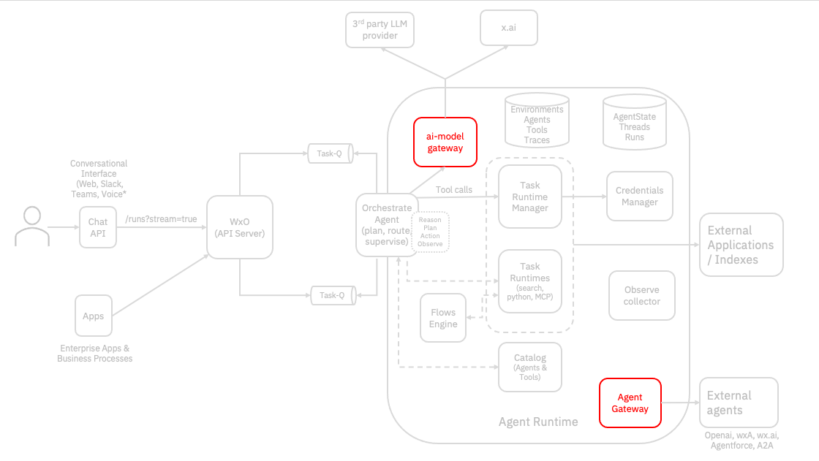
Agent Gateway/AI Model Gateway
AI Model Gateway
AI Model Gateway is responsible for communicating with LLMs for chat completion and embeddings from various model providers. LLM providers include watsonx.ai and external providers such as Anthropic and Open AI.
Orchestrate agents and the flow runtime use AI gateway for chat completions.
Knowledge based search uses AI Gateway for embeddings to support Retrieval Augmented Generation.
Agent Gateway
The Agent Gateway is responsible for connecting with external agents from other platforms that support the A2A protocol.
When an external agent is registered with a native agent in WxO as a collaborator, the native agent acts as an Orchestrator and will route the user query to external agent if it determines that the task can be better handled externally.
The Agent2Agent (A2A) Protocol is an open standard designed to facilitate communication and interoperability between independent, AI agent systems, introduced by Google.
Notes:
This slide describes the AI Model Gateway and the Agent Gateway. These gateways enable communication with language models and external agents.
On the left, we have the AI Model Gateway, which handles interactions with large language models (LLMs). It supports:
Chat completions and embeddings from various providers, including watsonx.ai, Anthropic, and OpenAI.
Orchestrate agents and the flow runtime rely on this gateway for generating responses and reasoning.
Additionally, it supports knowledge-based search by generating embeddings that power Retrieval Augmented Generation (RAG).
On the right, we have the Agent Gateway, which enables communication with external agents using the Agent2Agent (A2A) protocol—an open standard introduced by Google. When an external agent is registered as a collaborator with a native agent in watsonx Orchestrate, the native agent acts as an orchestrator. If the native agent determines that a task is better suited for the external agent, it will route the user query accordingly.

Slide 18
Agent development

Slide 19
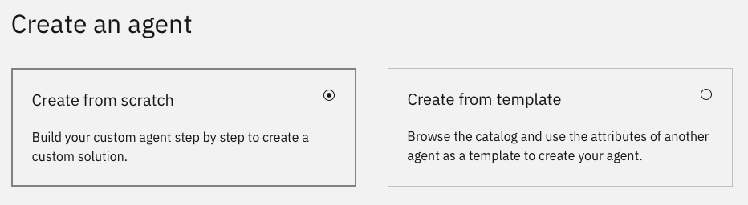




Agent Builder
The no-code AI Agent Builder provides the following capabilities:
Build, deploy & manage AI agents intuitively in a guided flow, no-coding required
Create agents grounded in business knowledge natively
Connect directly to the tools & collaborator agents needed to compete workflows & reach outcomes
Set agent behavior with instructions, rules & channels for control over the end-user experience
Easily preview, deploy & manage agents with insights into agent use & edits
Notes:
Agent builder provides a simple framework to build, deploy and manage agents without coding.
Agents can be grounded in business knowledge by uploading documents describing product features or procedure guides.
Tools, agents and collaborating agents can be configured, and agent behavior can be defined with detailed instructions for the agent to follow.
Agents can be built, previewed and deployed within Agent Builder without extensive technical knowledge.

Slide 20
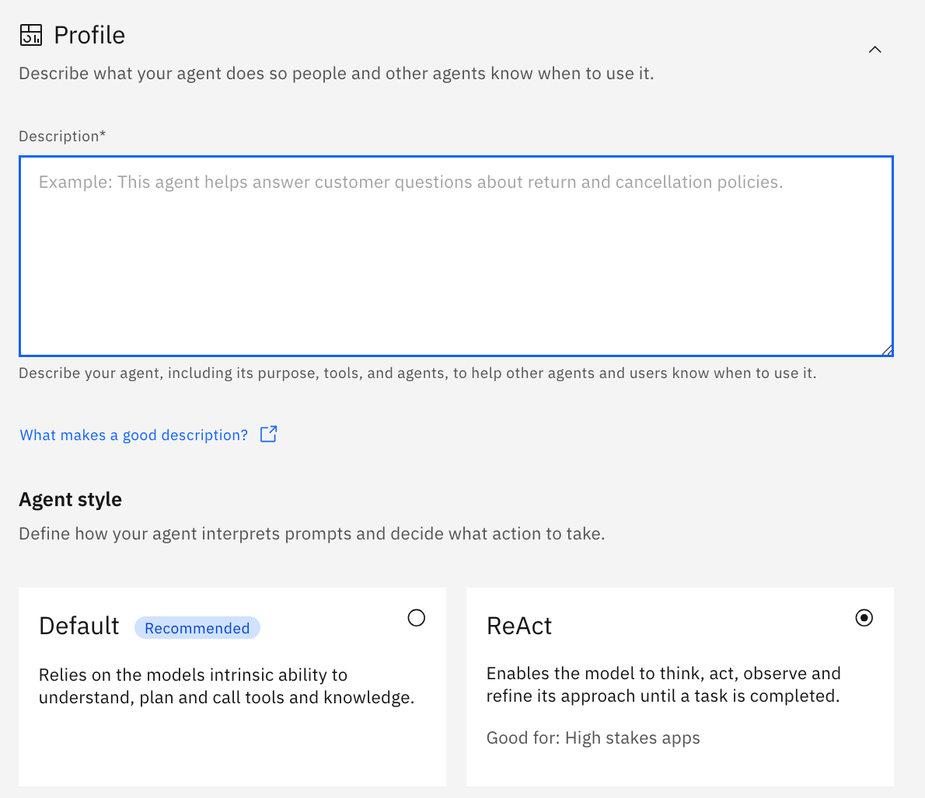
Profile
Choose to build agents from scratch or from a template
Give your agent a name & description to define its purpose
Select agent style
Notes:
Agents can be built from scratch or use a pre-defined template.
Here we see the profile of a new agent created from scratch.
This is where you provide the agent's name and description, and choose the agent style. The agent description is more than just an explanation of what the agent does, it’s used to describe its capabilities to other agents to enable agent to agent collaboration.
The agentic best practice presentation in this learning will detail the importance of a good and detailed agent description at this leveL

Slide 21
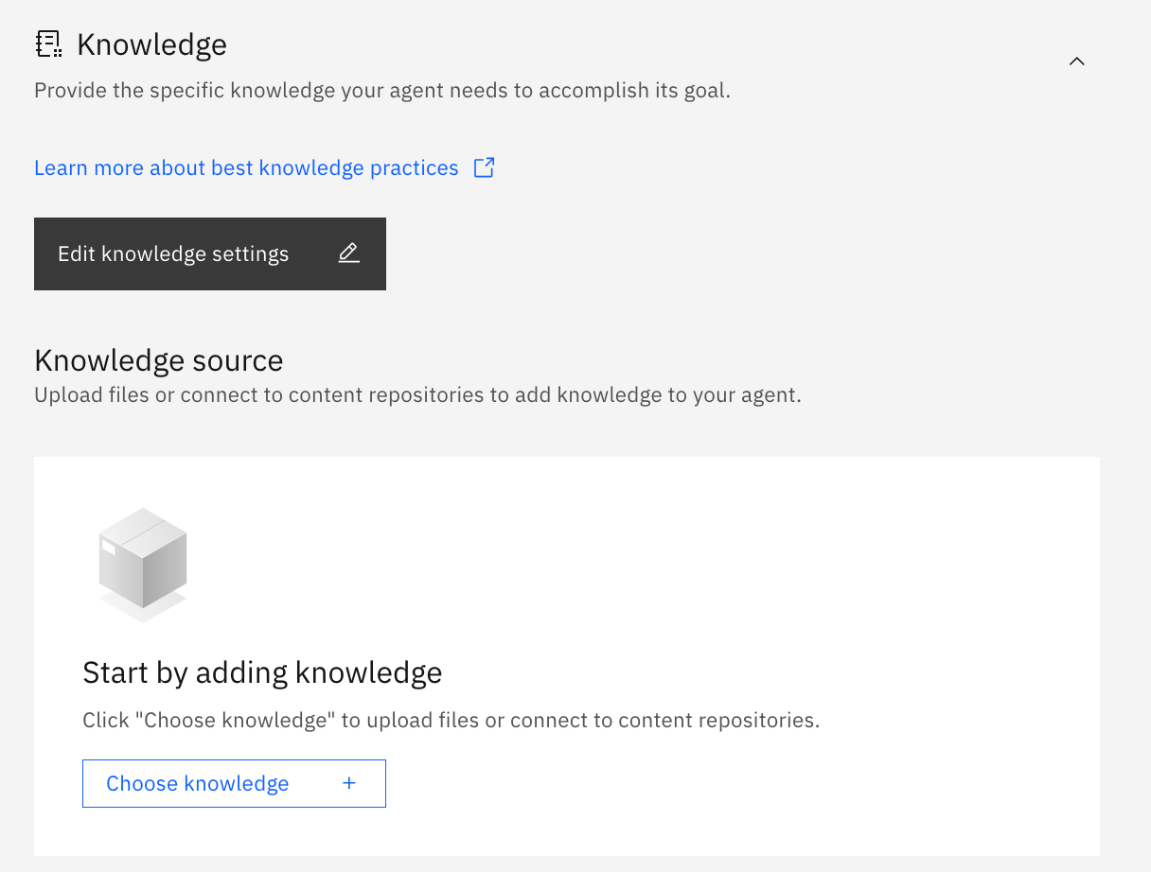
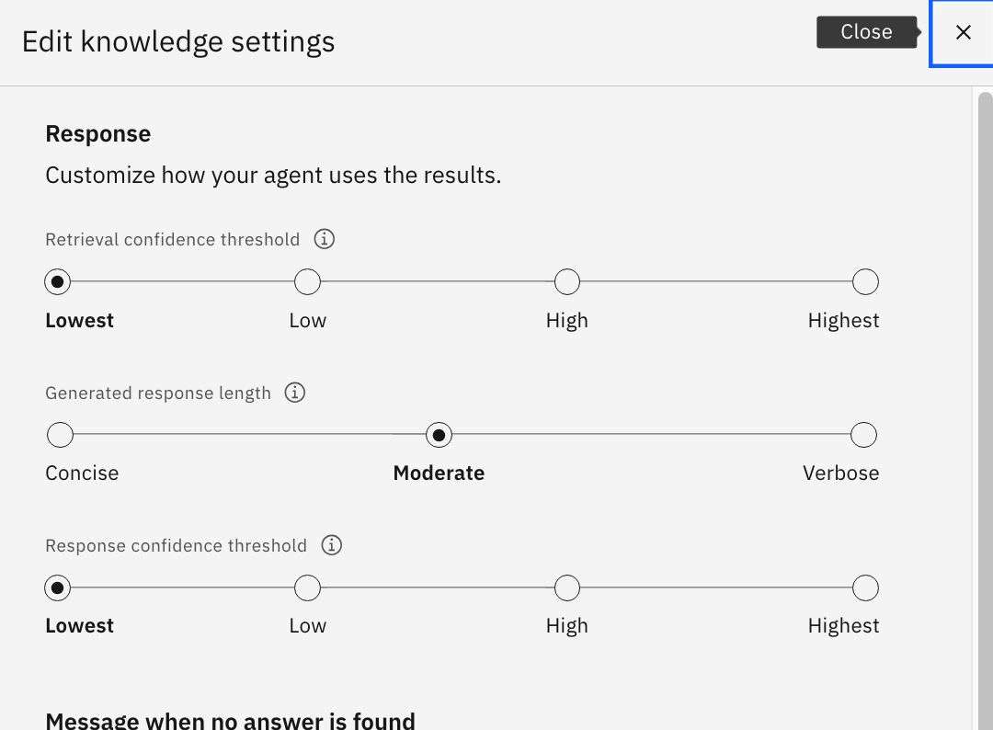
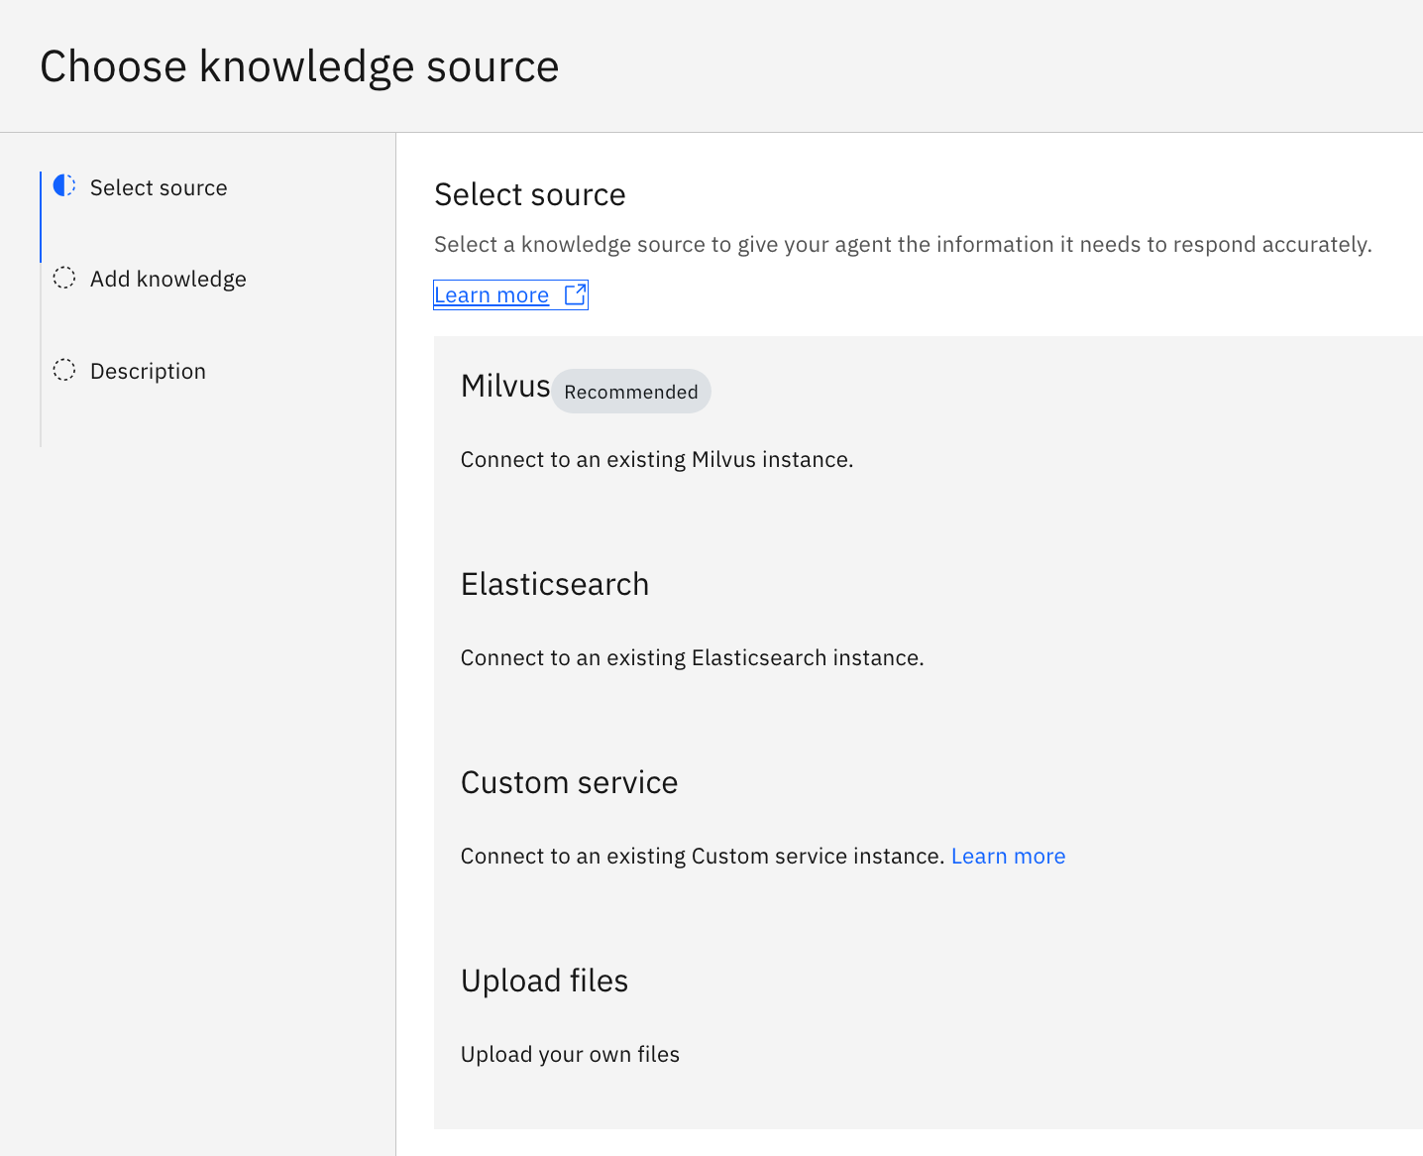
Knowledge
Add targeted knowledge for the agent to leverage through direct file upload or connect to an external repository
Edit knowledge settings
Notes:
Next you'll work on the agent’s knowledge.
This is a way to rapidly upskill your agent so it can have a conversation and answer specific questions pertinent to your use case. You can add to your agent’s knowledge by adding documents directly or connecting to vector databases.
Knowledge is typically created using procedure guides, instruction manuals and product information.

Slide 22
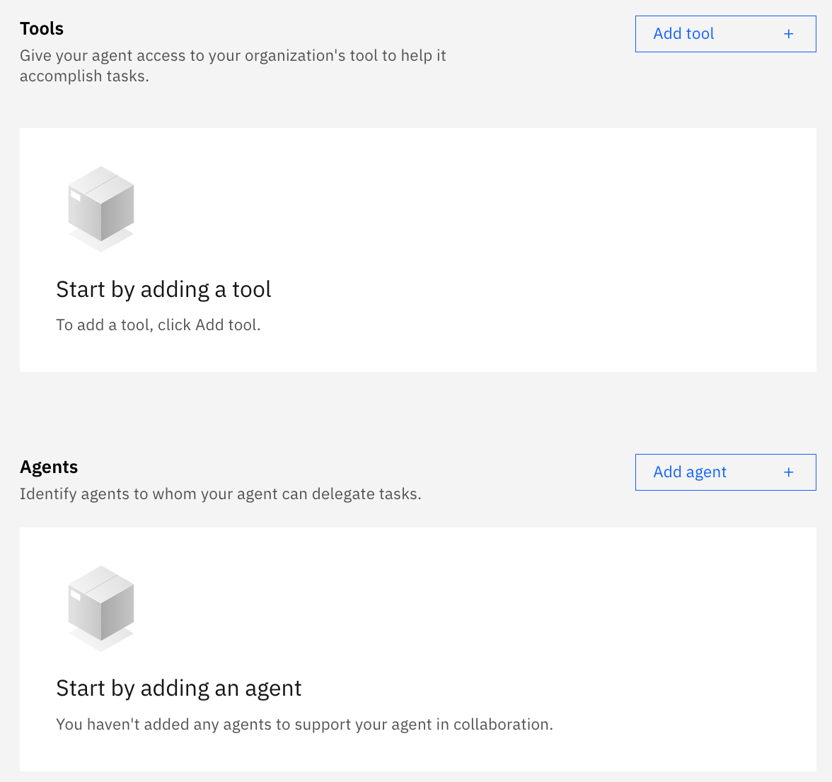
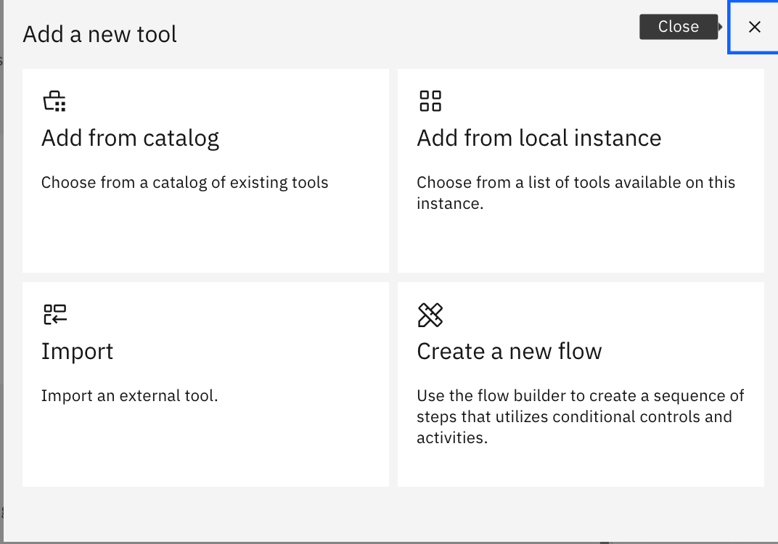
Toolset
Add tools & collaborator agents:
From the catalog
A local instance
Import from Open API and MCP tools
Create new tools with flows.
Notes:
Next is your agent's toolset.
The toolset is comprised of tools, things like open API specifications, Python scripts, flows, and other agents. Plugging in other collaborator agents can rapidly expand your agent's toolset and create a working agent in minutes.

Slide 23
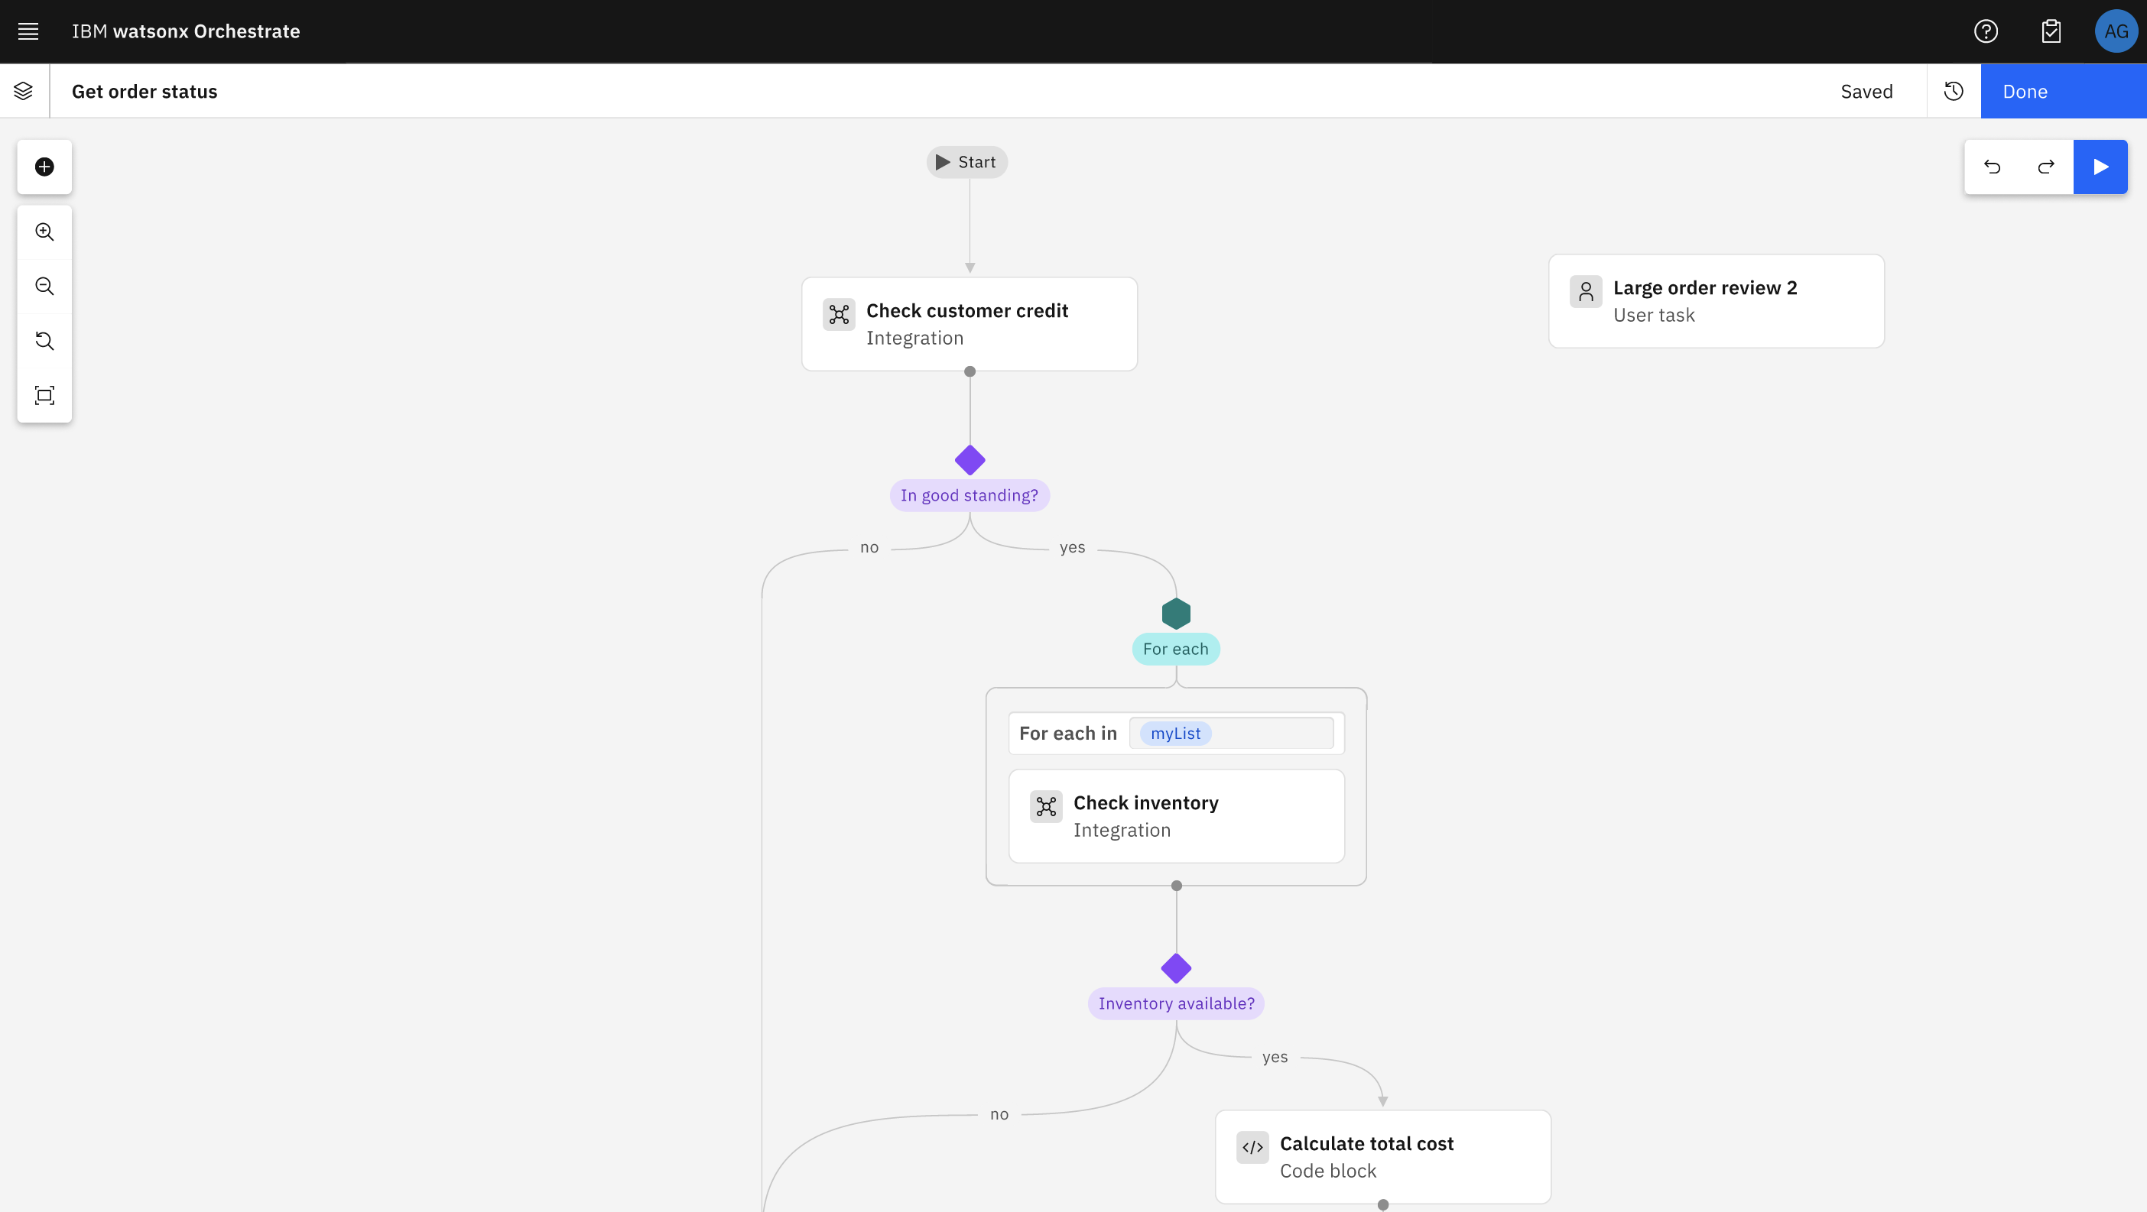
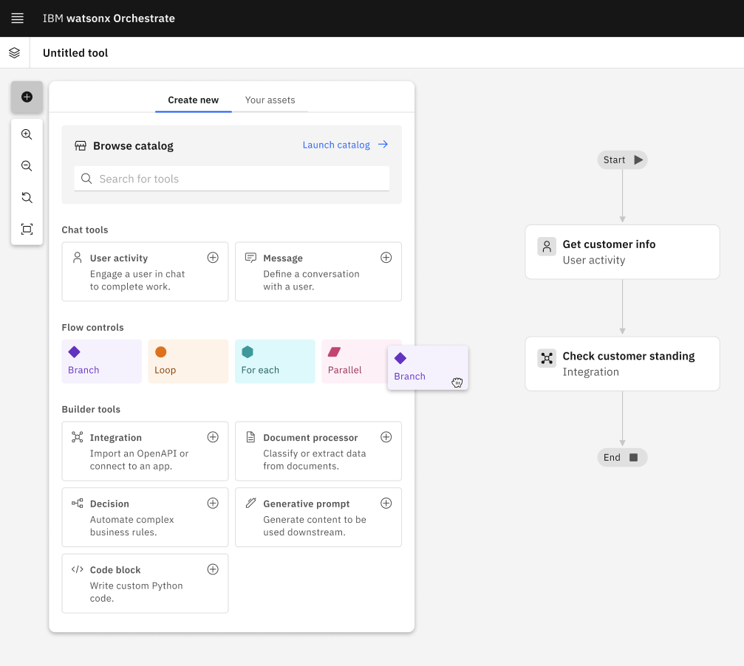
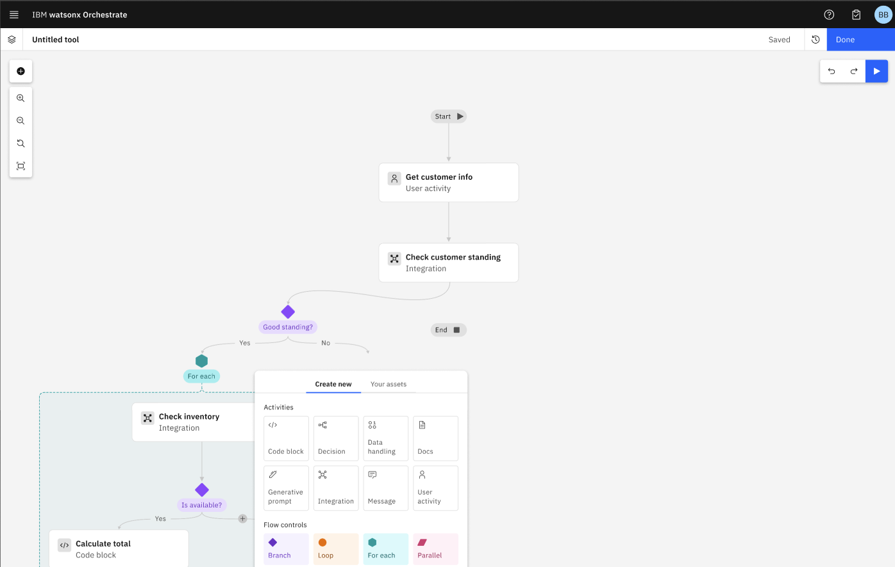

Create custom tools
Create tools visually from flows.
Low-code canvas for building any tool from a simple single node to a complex flow.
Create a sequence of linked activities and controls to achieve a specific goal.
Complements agentic task execution with prescriptive activities for when precision and consistency is required.
Combine user activities, code blocks, generative prompts, document classifiers and extractors.
Notes:
Flows enable the creation of custom tools using deterministic, fixed-flows for combining tools and agents.
It allows for precise control over how certain actions will be performed and replaces agentic reasoning with pre-defined branching and looping for improved consistency and performance for scenarios where these qualities are more important than agentic creativity and problem solving.

Slide 24
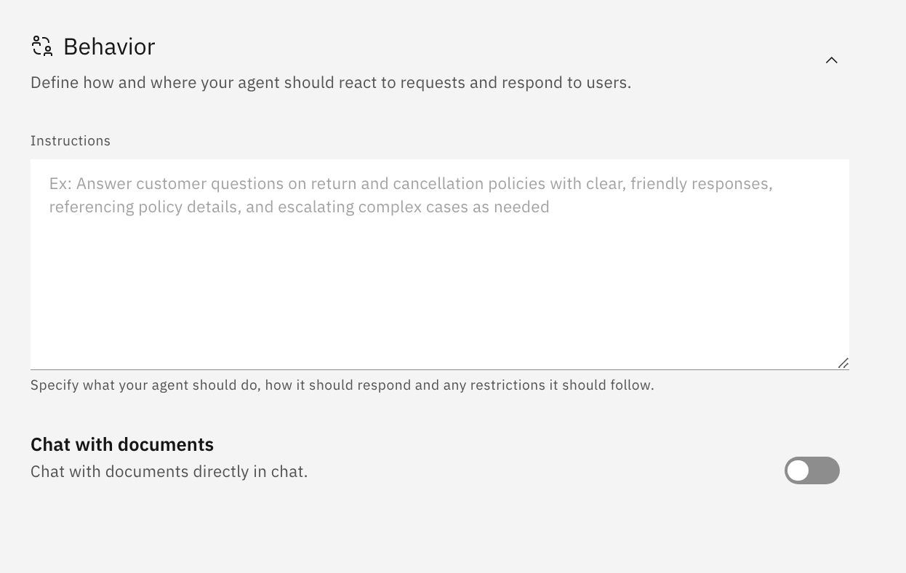
Behavior
Provide instructions on what the agent should do, how it should respond & any restrictions
Activate the channels where the agent will be active
Preview directly from build UI
Notes:
Behavior controls how the agent operates.
Natural language is used to define the agents' instructions, providing the agent with guidance to complete the task, information for using tools, and the kind of tone it should adopt when talking to users.

Slide 25
ADK
Tools for building agents
Packaging
On Premises, SaaS and Developer Edition
The IBM watsonx Orchestrate Agent Development Kit (ADK) is a set of tools designed to make it easy to build and deploy agents using watsonx Orchestrate.
Packaged as a Python library and command line tool that allows builders to configure agents that run on the IBM watsonx Orchestrate platform.
A VSCode plugin helps developers work more efficiently.
Works with multiple watsonx Orchestrate environments.
On-premises
IBM Cloud
AWS
Developer Edition
Developer edition requires a suitable container manager supporting Docker and Docker Compose.
Notes:
In addition to the agent builder, the Agent Development Kit, or ADK, provides additional developer tools for building and deploying agents on the watsonx Orchestrate platform.
The ADK is designed to simplify the agent development process. It offers a comprehensive set of tools that help developers create agents that can interact with users, perform tasks, and integrate with enterprise systems.
The ADK is packaged as a Python library and a command-line tool, making it familiar for developers with experience with Python. These tools allow builders to configure agents and tools that contain Python code, something that can’t be done within the low-code agent builder. A VSCode plugin simplifies agent development and provides improved visibility of agents deployed locally and in remote environments.
It supports multiple environments including on-premises, IBM Cloud, AWS, and a local Developer Edition. The Developer Edition is particularly useful for local testing and prototyping; this requires a container manager that supports Docker and Docker Compose to run the local environment.

Slide 26
ADK feature highlights
Agents
Create agents with greater control over their configuration and access to advanced features such as access context variables.
Tools/Toolkits
Tools in the ADK can use Python, accept and return files.
Tools can be created from OpenAPI and MCP.
Knowledge
Create, import, list, update, and delete knowledge bases, giving you full control over how your agents access and manage information.
Models
Use third party models using the AI gateway. Set policies to handle routing between multiple models for use cases such as load-balancing and fallback.
Connections
Manage connections to external services for tools and knowledge bases.
Provide credentials for OpenAPI and Python tools.
Evaluations
Use user stories to test the behavior of agents.
User stories provide conversation context, goals and expected results used for evaluating responses.
Notes:
This slide describes the key features of the Agent Developer Kit.
The ADK offers enhanced configuration options to create agents with fine-grained control, including access to advanced features like context variables, which help agents maintain state and personalize interactions.
Developers can build tools using Python that accept and return files. Additionally, tools can be created from OpenAPI specifications or using the Model Context Protocol (MCP), offering flexibility for agents connecting with external systems.
The ADK allows you to create, import, list, update, and delete knowledge bases. This provides full control over how agents access and manage information, enabling tailored responses and improved contextual awareness.
The ADK supports integration with third-party models via the AI Gateway. Developers can define routing policies to manage multiple models—useful for scenarios like load balancing or fallback when a primary model is unavailable.
Connections are essential for integrating with external services. The ADK allows you to manage these connections and securely provide credentials for tools built using OpenAPI or Python, ensuring seamless and secure interoperability.
Finally, Evaluations are supported through user stories. These stories define conversation context, goals, and expected outcomes, allowing developers to test and validate agent behavior in realistic scenarios.

Slide 27
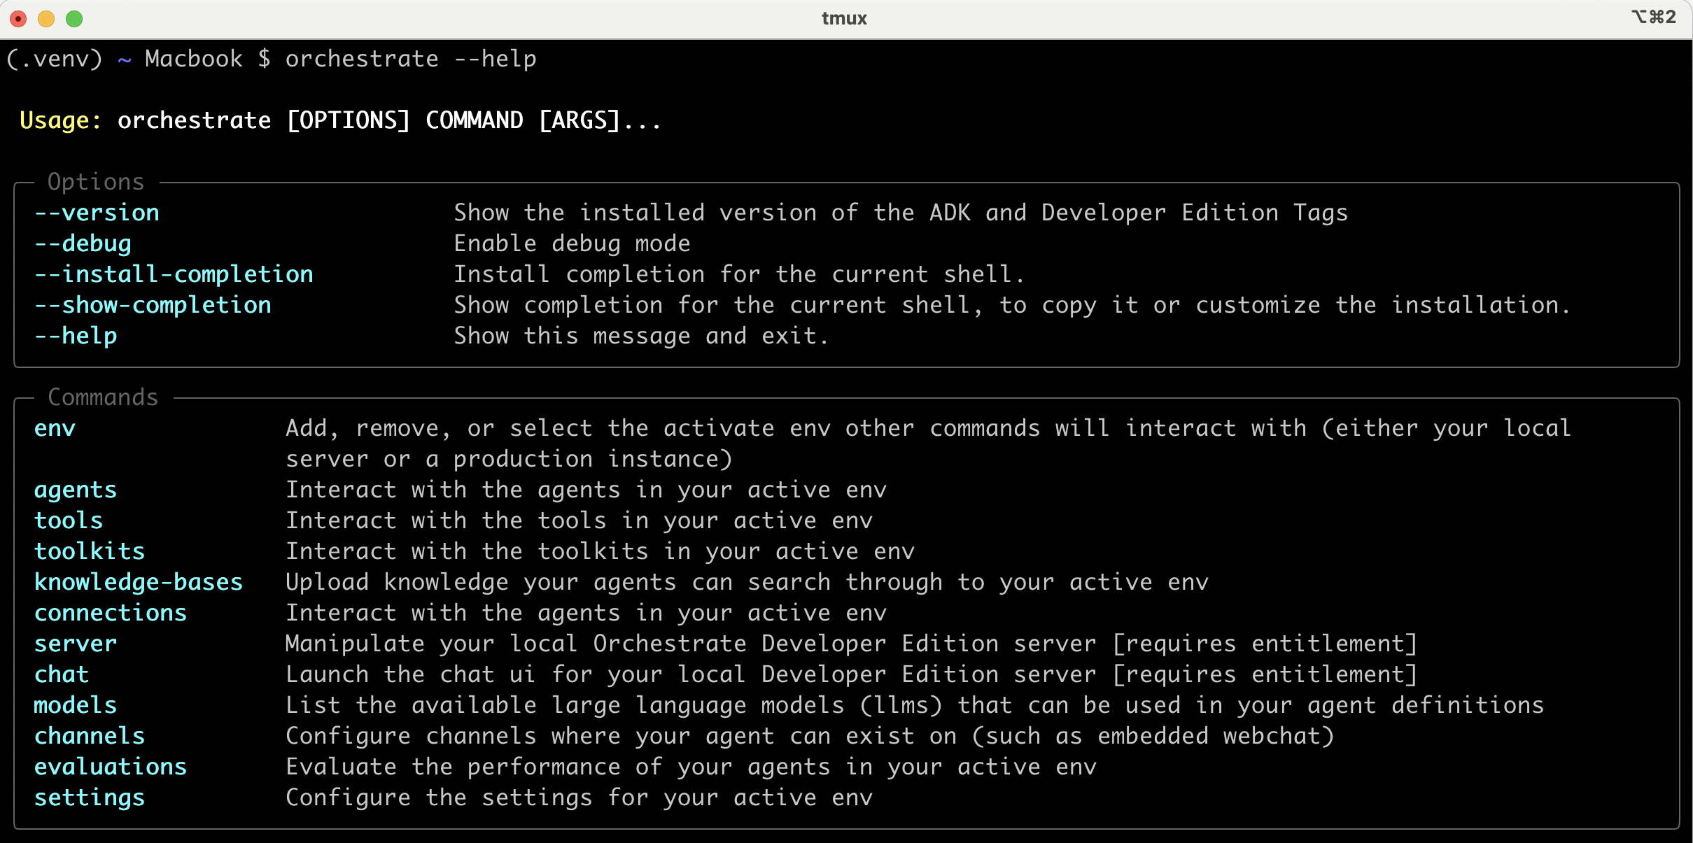
ADK command highlights
Options
Commands
Notes:
This slide outlines the command line interface provided by the Agent Developer Kit.
At the top, we see general options that enhance usability, then a list of available commands grouped by functionality:
env: Manage environments—whether local or production—by adding, removing, or selecting the active one.
agents: Create and configure agents, including advanced features like context variables.
tools and toolkits: Build and manage tools that agents can use, supporting Python, OpenAPI, and MCP formats.
knowledge-bases: Upload and manage searchable knowledge sources for agents.
connections: Configure secure connections to external services and tools.
server: Control and interact with the local Developer Edition server.
chat: Launch the chat UI for your local development server.
models: List and manage available LLMs for agent use.
channels: Define where agents can be deployed, such as embedded webchat.
evaluations: Test agent behavior using user stories that simulate real-world interactions.
settings: Configure environment-specific settings.
Numerous ADK related labs will teach you how to use these different commands in this learning plan. This concludes this wxO Architecture overview presentation.

Slide 28
Notes:
This slide is self explanatory and requires no speaker notes.

